Slide 1
CPBP 8306: Animations
Stevenson Science & Engineering Library
Joshua Borycz

Slide 2


Post-test assessment
http://tiny.cc/cpbp8306postassessment

Slide 3
Next week
2-3 minutes each
3 slides each
Upload slides to Brightspace the day before so I can combine them
Donuts and coffee with be provided
Questions?

Slide 4
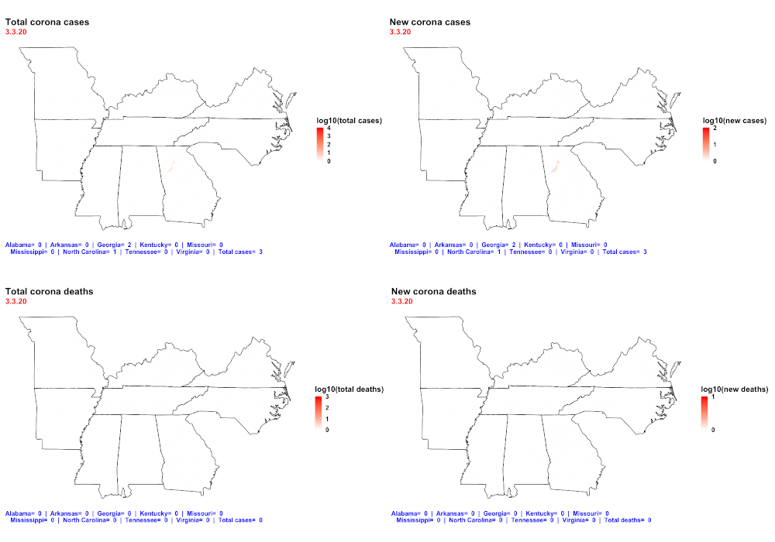
Animations

